Slide 1
1st Year
Subject Choice
Loreto College
2022/2023

Slide 2
Important Considerations
Your interest in the subject
Your ability in the subject

Slide 3
Loreto College
All First Year Students Study:
English (HL or OL)
Irish (HL or OL)
Mathematics (HL or OL)
History (Common)
Geography (Common)
Science (Common)
Physical & Health Education (Wellbeing)
Choir (Wellbeing)
CSPE (Wellbeing)
Religion (non-exam)
Digital Literacy (Computing) (non-exam) only in 1st year.

Slide 4
Three Other Subjects….
What to Choose?

Slide 5
Loreto College Subject Options
Visual Art
Home Economics
Music
German
Spanish
French
Business Studies
Classical Studies with Latin*

Slide 6
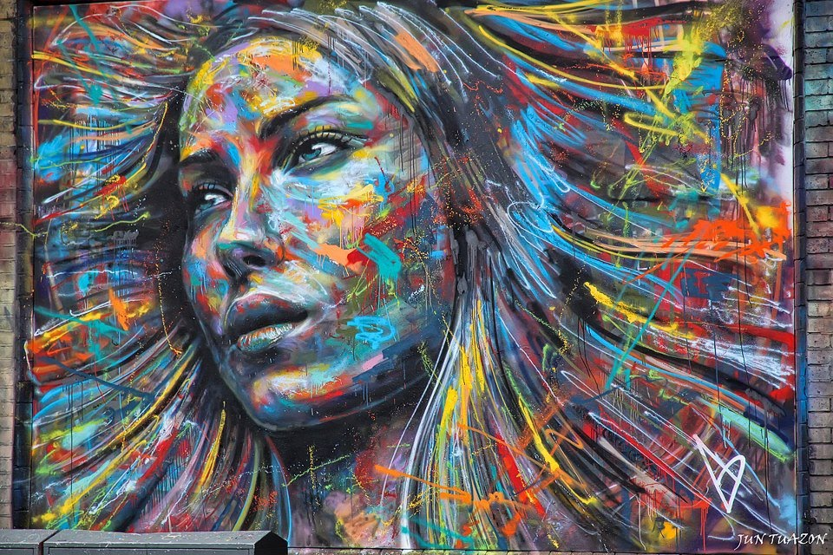
Visual Art

Slide 7
Visual Art
How is it Assessed?

Slide 8
Visual Art
How you will be examined:
Year 2-Term 2 Classroom Based Assessment 1
Year 3- Term 1 CBA 2
Individual Project
There is no Assessment Task or Final Drawing Examination

Slide 9
Art
How it will be useful to you:
Many of the skills you learn will be very useful outside of school.
Areas covered in Visual Art are: Media, Art Elements and Design, Visual Culture and Appreciation, Drawing, Critical and Visual Language.

Slide 10
Home Economics

Slide 11
Home Economics
What you will do/ learn about:
Your body – what is good to eat and how to keep healthy.
Food - how it nourishes your body, how to choose, prepare and cook it.
Using money – how to spend it wisely, how to save it, and how you are protected as a consumer.
Your home – about design in the home, about safety and hygiene.

Slide 12
Home Economics
How you will be examined:

Slide 13
Home Economics
How it will be useful to you:
You will be able to use the information in your everyday life; from looking after yourself, to shopping and caring for others.
There are a number of cross curricular elements to this subject.

Slide 14
Music

Slide 15
Music
What you will do/ learn about:
You will sing and take up the recorder & ukulele in First Year
You will listen to many types of music such as pop, classical and traditional Irish music.
You will also start composing.
It is not necessary to already play an instrument.

Slide 16
Music
How you will be examined:

Slide 17
Modern Languages

Slide 18
German

Slide 19
Spanish

Slide 20
French

Slide 21
Modern Language
What you will do/ learn about:
How to speak in the language about yourself, your
family and friends, your hobbies, your school.
This will help you to talk to people who speak the language.
The skills of listening to, reading and writing in the language.
Information about the countries where people speak the language.

Slide 22
Modern Language
How you will be examined:

Slide 23
Modern Language
How it will be useful to you:
Useful for travelling and careers such as Tourism, Education, Business and Translation.
NUI universities require you to have a Modern Language to enter some of their courses.

Slide 24
Business Studies

Slide 25
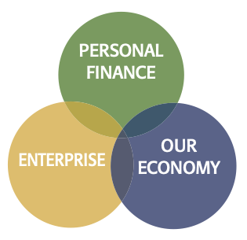
Business Studies
What you will learn about:
Personal Finance focuses on students making informed decisions to effectively and responsibly manage their financial resources. This includes Budgeting, Financial services and Consumer Rights & Responsibilities.
Enterprise encourages students to identify opportunities and develops an understanding of the financial, marketing and operational functions of an organisation. This includes a practical project setting up their own business.
Our Economy enables students to understand the dynamic relationship between the local, national and international economic situation.
Notes:
Course broken into three interconnecting elements - Personal Finance, Enterprise and Economics.

Slide 26
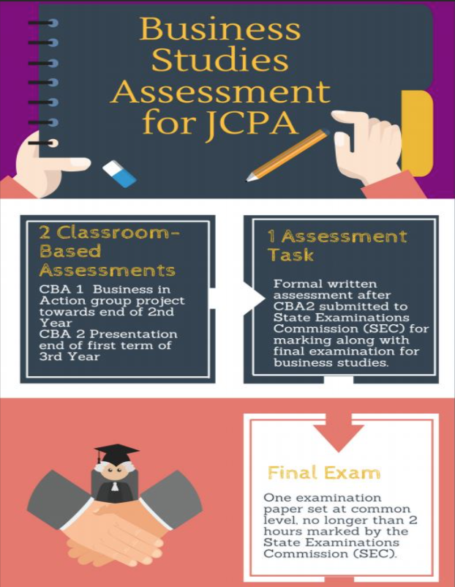
Business Studies
How is it
Assessed?
Notes:
CBA1 is a group based project where students research and develop their own product and prepare a Business Plan. Based on Teamwork, Research, IT and Communication skills
CBA2 is an individual project where students research a topic of interest and prepare a presentation on their findings and evaluation. Based on Critical thinking, Research, IT and Presentation skills.
Assessment Task is based on the students reflection of learning in CBA2 and is 10% of final grade awarded
Terminal written exam accounts for 90% of final grade.

Slide 27
Business Studies
How it will be useful to you:
This is a life skills based subject, introducing students to the work environment, budgeting, saving, investing and borrowing. The skills developed aim to equip students with the knowledge to make informed and responsible decisions with all the resources available to them.
Business studies aims to stimulate students’ interest in the business environment and how they interact with it.

Slide 28
Classical Studies
Classical Studies

Slide 29
Classical
What you will do/ learn about:
Course breaks down to approx 50% History and 50% Latin
• How to read, understand and enjoy Latin.
• How to translate interesting stories in Latin.
• Find out who the Ancient Greeks and Romans were, what they achieved and why they remain important to us today.

Slide 30
Classical Studies
How you will be examined:
CBA 1 & 2
Assessment Task during CBA 2 to be marked by the SEC (10%).
Written Examination (SEC) (90%)

Slide 31
Classical Studies
How it will be useful to you:
You will quickly begin to make connections with words you have already met in your primary school in English, Irish and other languages.

Slide 32
Subject Choice

Slide 33
Loreto College Subject Options
Art
Home Economics
Music
German
Spanish
French
Business Studies
Classical Studies with Latin

Slide 34
We Recommend....

Slide 35
You should…
(a) Focus on what you think you’ll enjoy
(b) Consider the subjects you are good at and subjects which you may not have studied before in Primary School
(c) Take into account the work load involved.
(d) Take the Modern Language (not compulsory)
Notes:
Subjects to take up- business, accounting, economics, home economics, music and art (special cases)

Slide 36
You should…
(e) Talk to friends/brothers/sisters who study it.
(f) Try not to pick subjects based on what their friends are doing.
(g) Take a look at: JCT.ie for more information on each subject.

Slide 37
Best of Luck with your Decision!!
Donnchadh O Mahony
Guidance Counsellor

