Slide 1
Video
Notes:
Jackie

Slide 2
Class of 2021 - 2027
Information Evening
Tuesday 2nd February
Notes:
Jackie

Slide 3
Welcome
Notes:
Jackie

Slide 4
This evening you will be hearing from:
Ms Jackie Dempsey - Principal
Mr Des Fitzgerald - Deputy Principal
Ms Jane Kelly - SEO
Mr Donnchadh O’Mahony - Career Guidance Counsellor
Mr Dave Fagan - CompuB
Notes:
Jackie

Slide 5
Loreto College
St. Stephen’s Green
Principal’s Welcome
Ms Jackie Dempsey

Slide 6
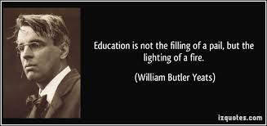

Slide 7
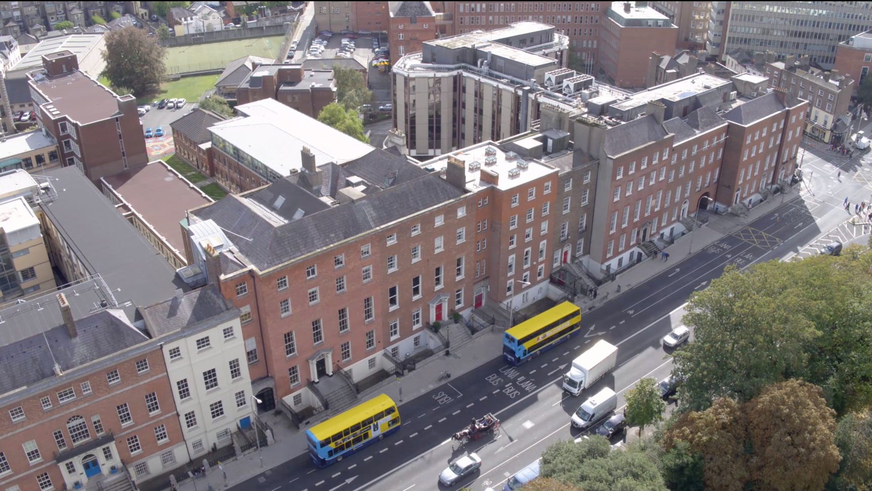
Notes:
Jackie

Slide 8
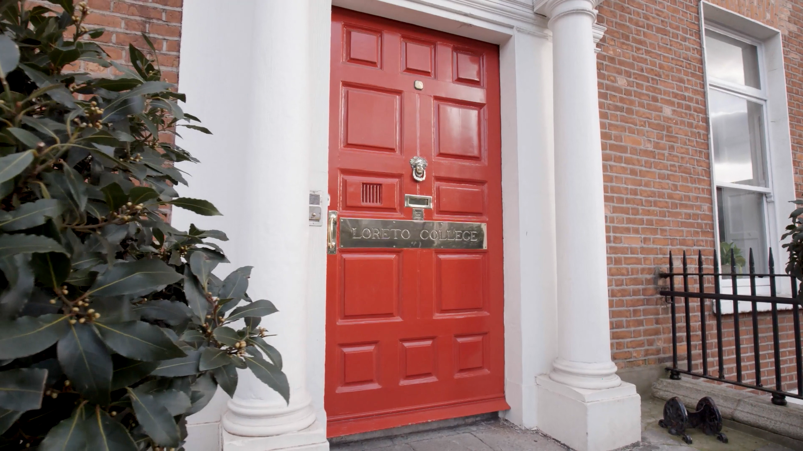
Notes:
Jackie

Slide 9
Loreto College
St. Stephen’s Green
School Ethos
Mr Des Fitzgerald
Notes:
Des

Slide 10
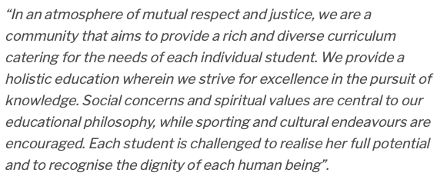
Notes:
Des

Slide 11
Our History
Loreto College, St. Stephen’s Green is a Catholic school in the Loreto tradition. It is, therefore, part of a worldwide network of schools run by the Institute of the Blessed Virgin Mary (known to us as Loreto).
Notes:
Des

Slide 12
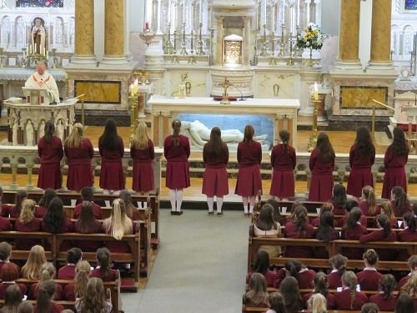
Here in Loreto St Stephen’s Green we aim to:
Position the person and best interests of the student at the centre of what we do.
Nurture respectful and caring relationships between teachers and students.
Provide an appropriate and robust learning experience and environment.
Set each student on a pathway to personal excellence, recognising different aptitudes and gifts.
Foster in students a generosity of spirit and a readiness to place their talents at the service of others.
Collaborate with parents in accompanying each student’s progress towards maturity.
Respect and honour diversity, entering into genuine dialogue with unfamiliar cultures and new developments.
Strengthen links between the world-wide network of Loreto schools and students.
The Loreto College’s philosophy of education is:
Centred in God.
Rooted in Gospel values.
Derives its objectives and specific expression from the insights and vision of St. Ignatius of Loyola and Mary Ward.
Notes:
Des

Slide 13
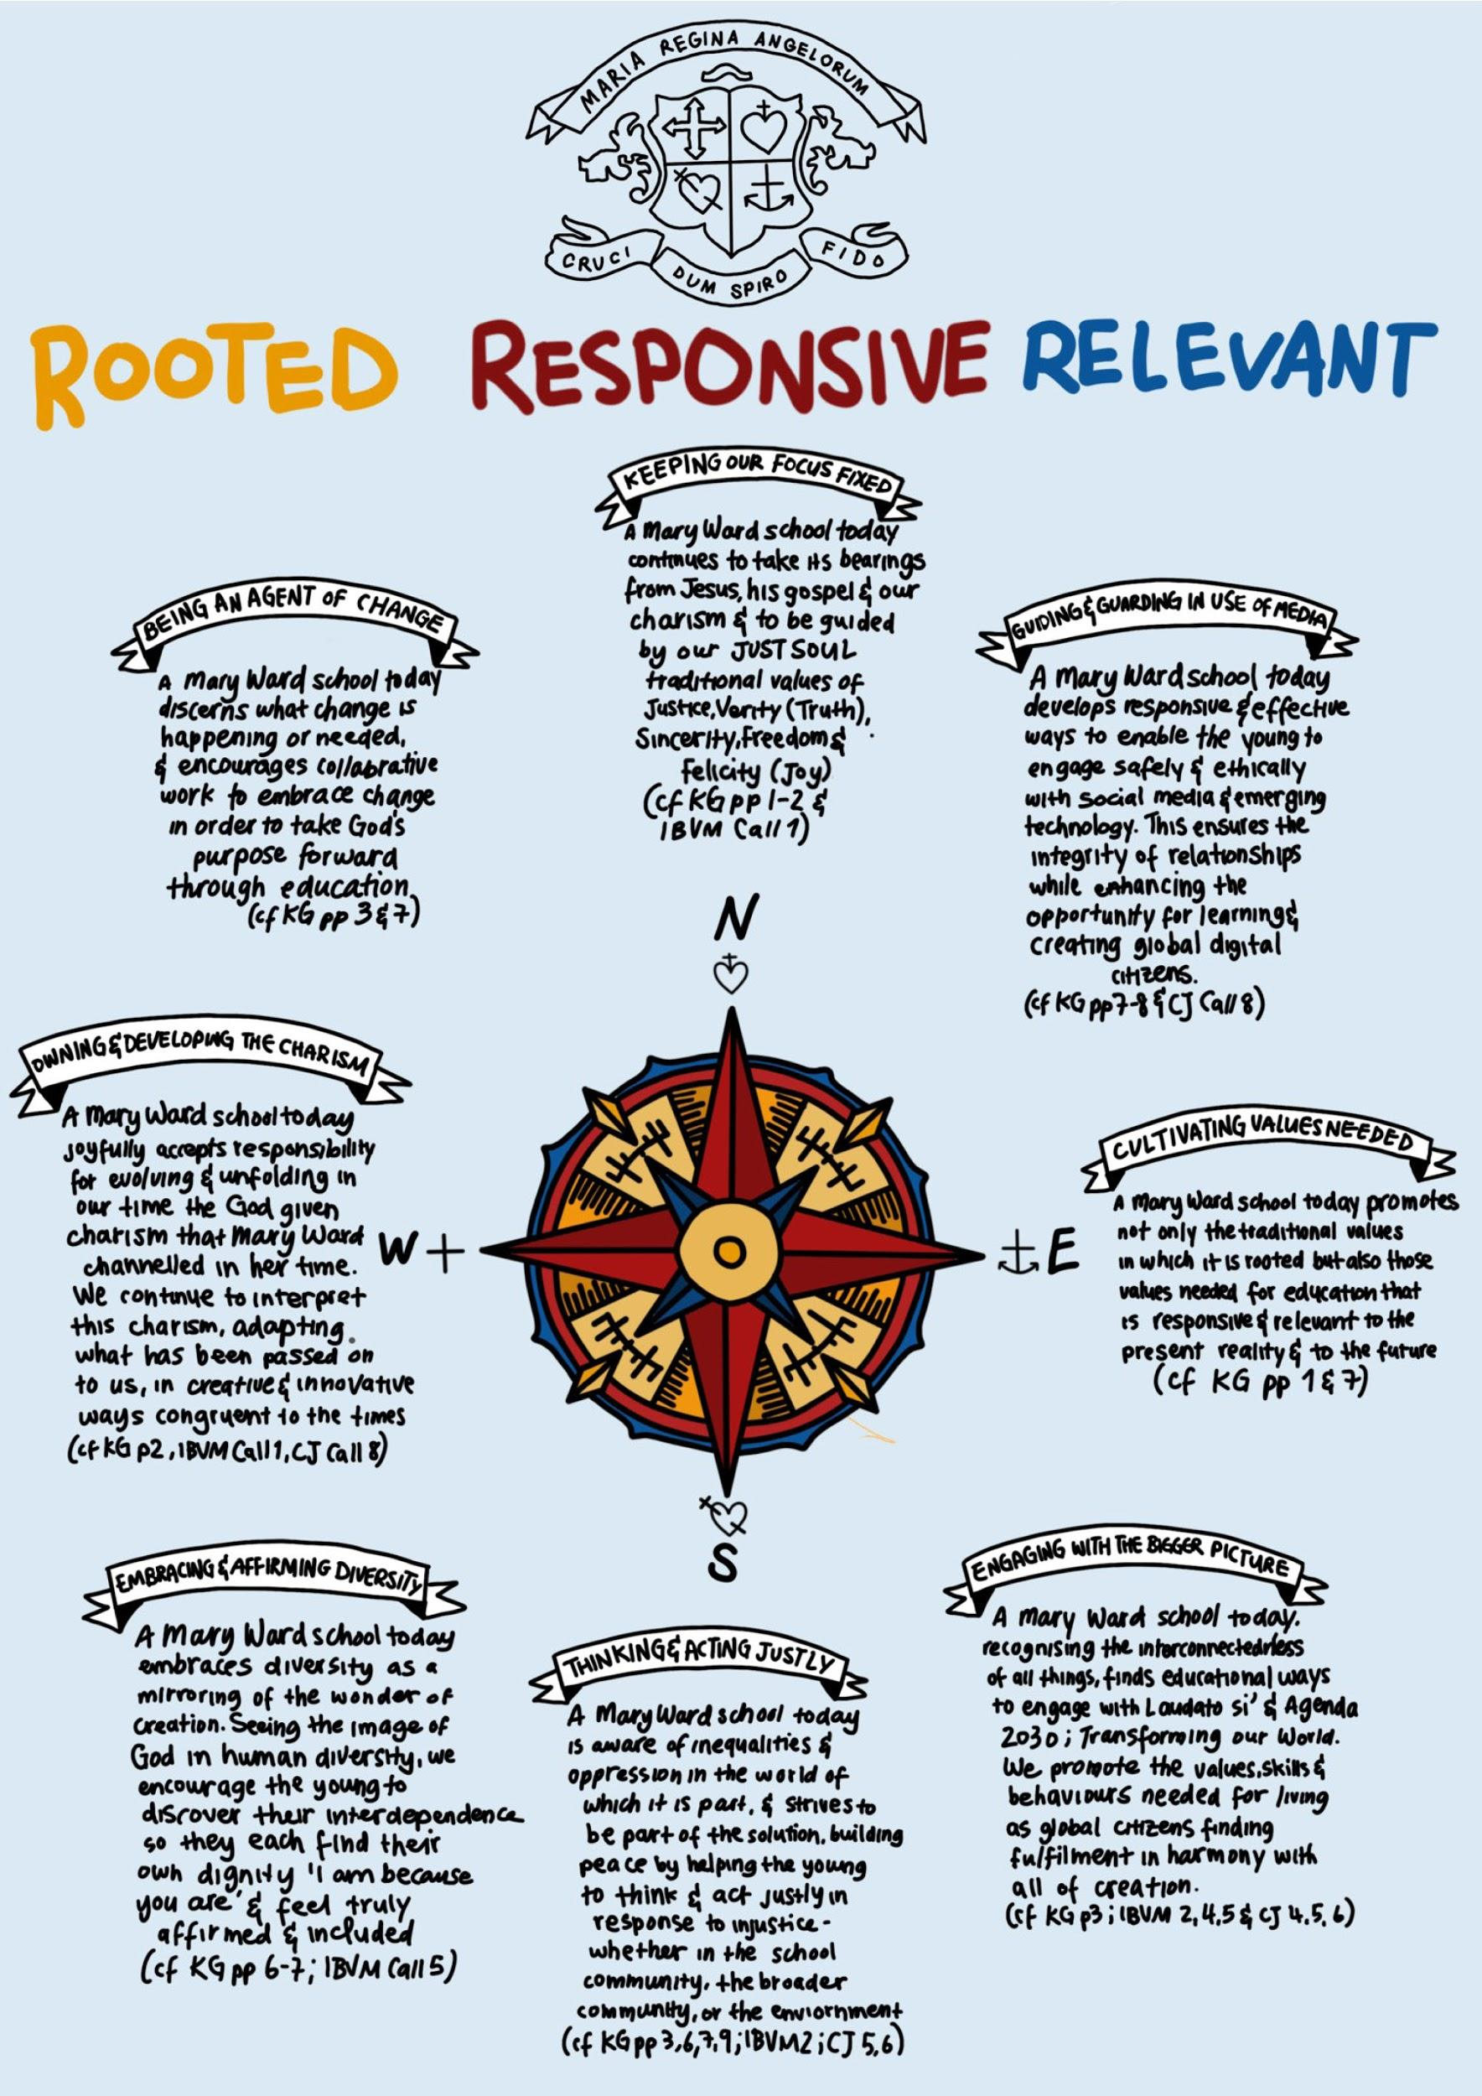

Slide 14
Notes:
Des - optional slide????

Slide 15
Loreto College
St. Stephen’s Green
Pastoral Care Team
Notes:
Des

Slide 16
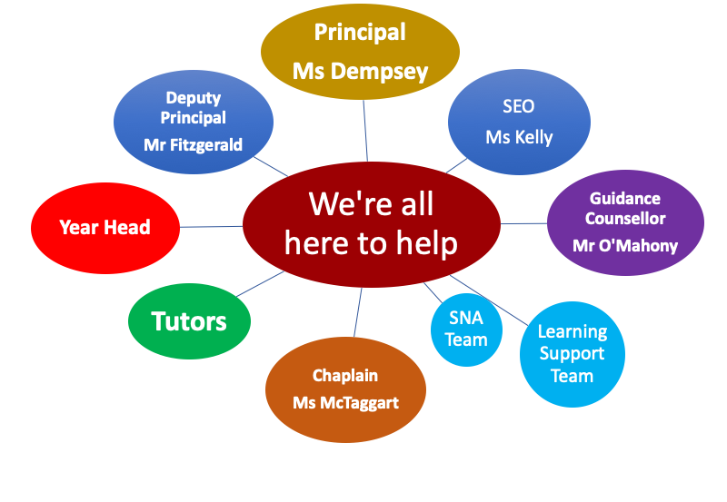
Pastoral Team
Notes:
Des

Slide 17
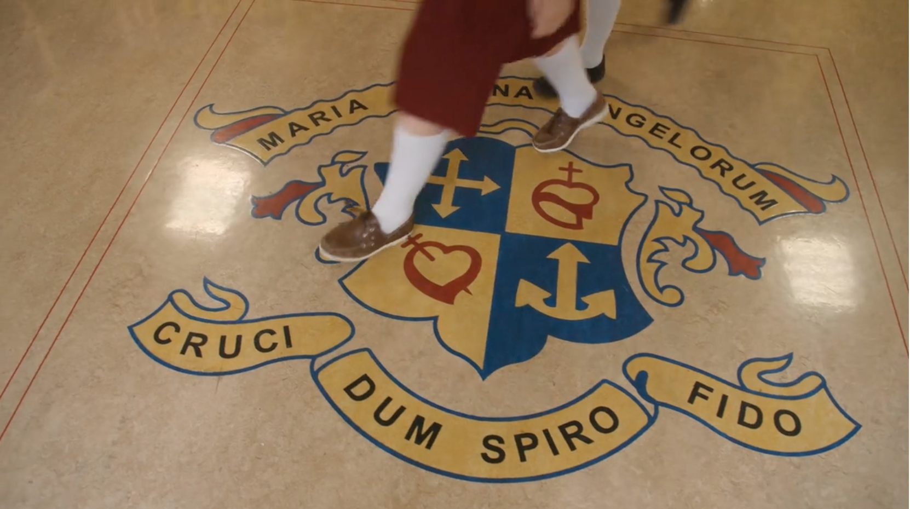

Slide 18
Loreto College
St. Stephen’s Green
Teaching and Learning
Ms Jane Kelly
Notes:
Jane

Slide 19
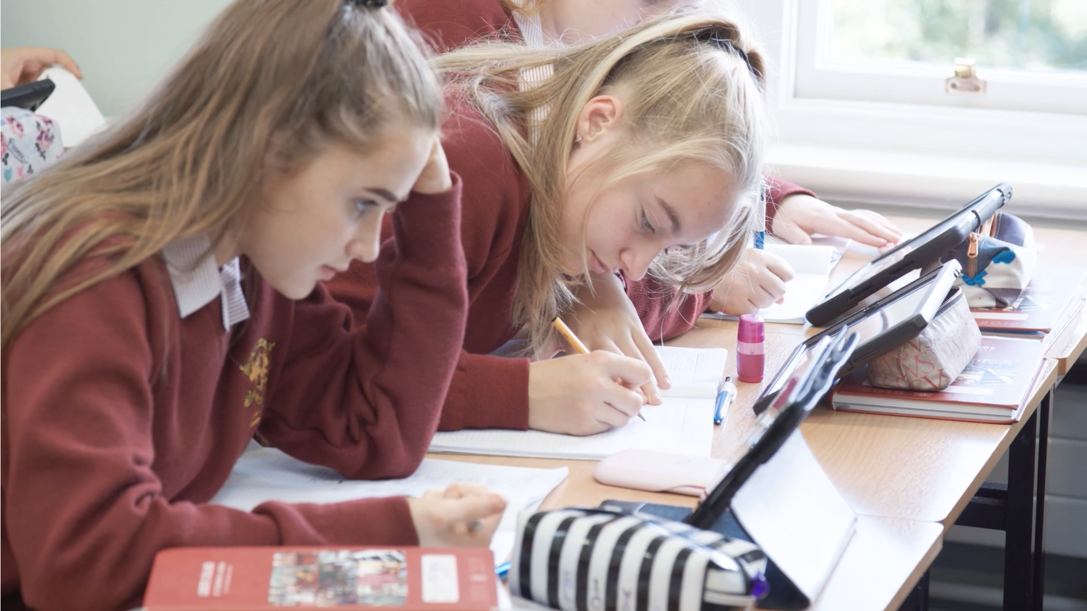

Slide 20
School Day
 | Monday | Tuesday | Wednesday | Thursday | Friday
8:45am Start | Classes | Classes | Classes | Classes | Classes
10:45am | Break | Break | Break | Break | Break
10:55am | Classes | Classes | Classes | Classes | Classes
12:55pm | Lunch | Lunch | Finish | Lunch | Lunch
1:45pm | Classes | Classes |  | Classes | Classes
3:45pm Finish | Finish | Finish |  | Finish | Finish
Tutor time two mornings a week and Assembly once a week at 8:30am - days may vary depending on Year Group
Notes:
Jane

Slide 21
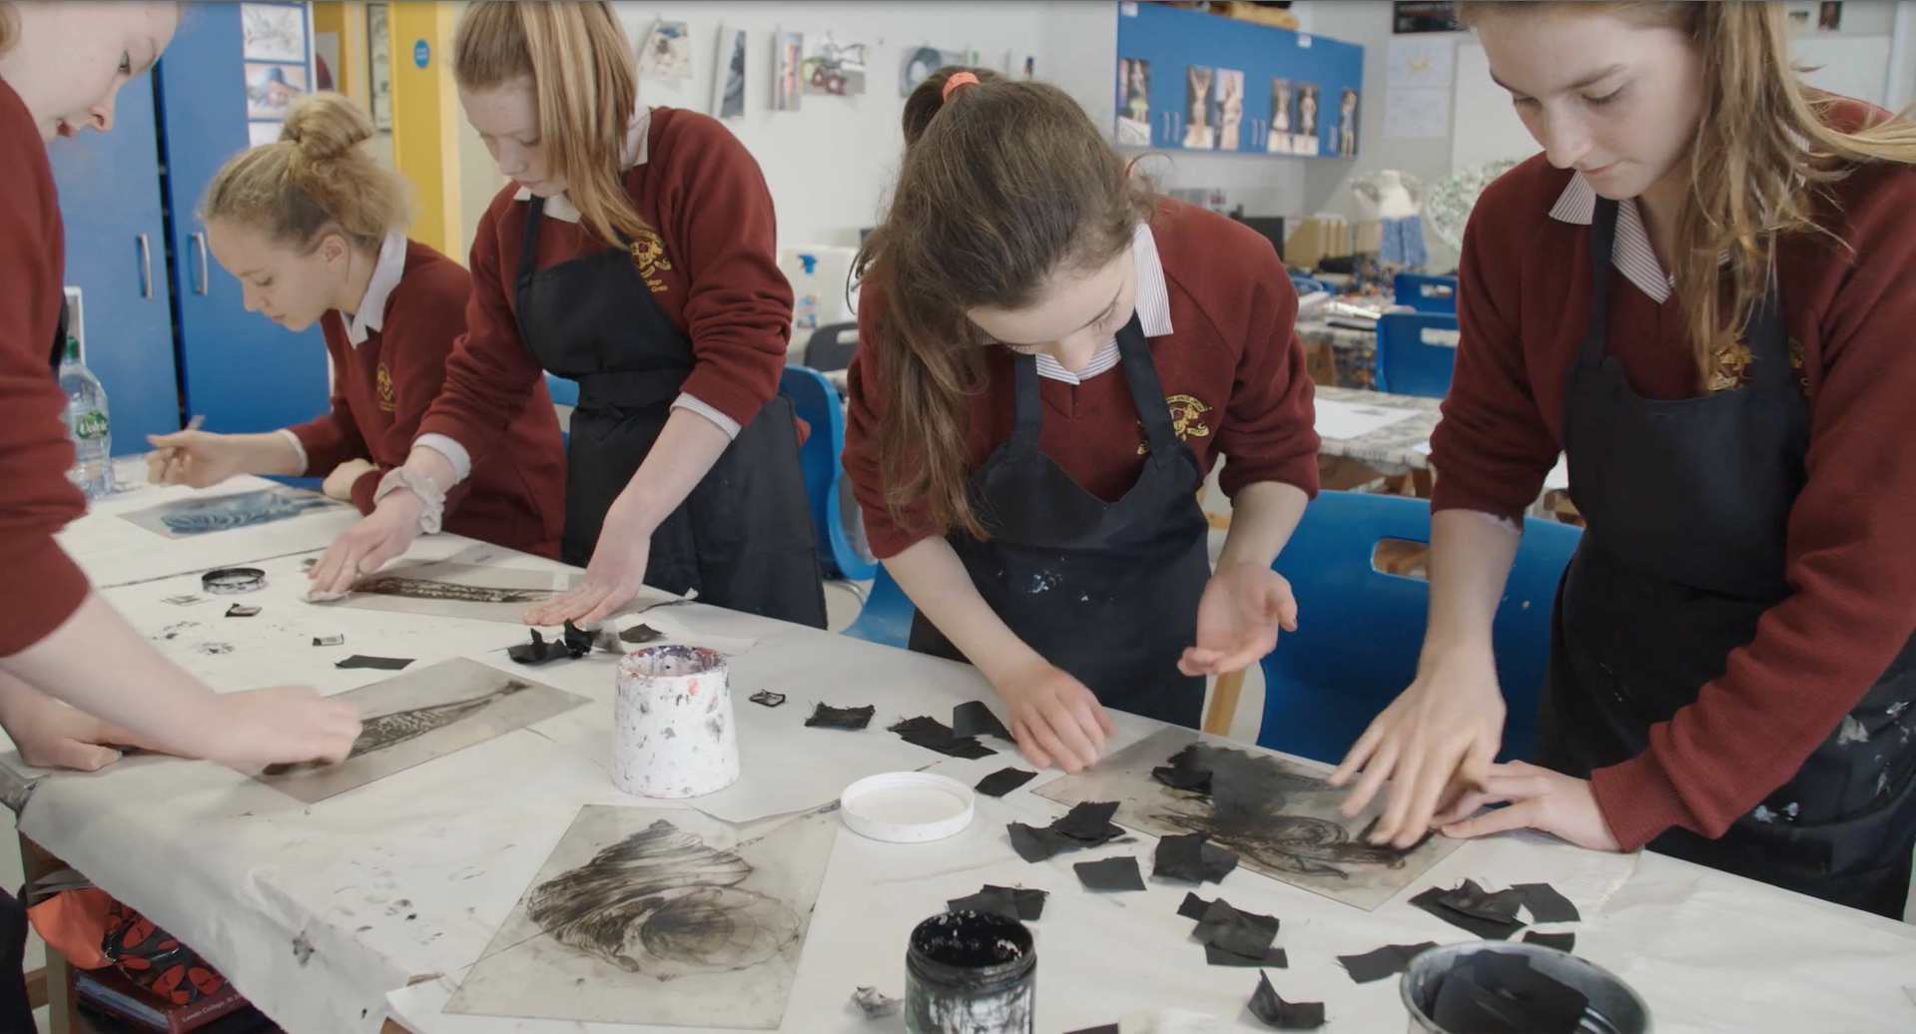

Slide 23
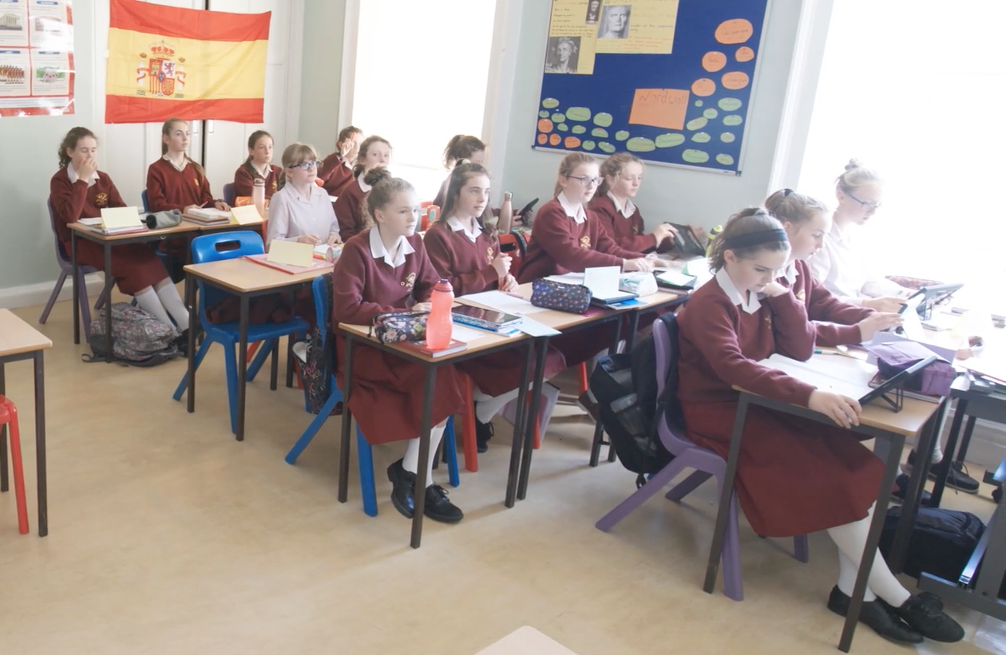

Slide 25
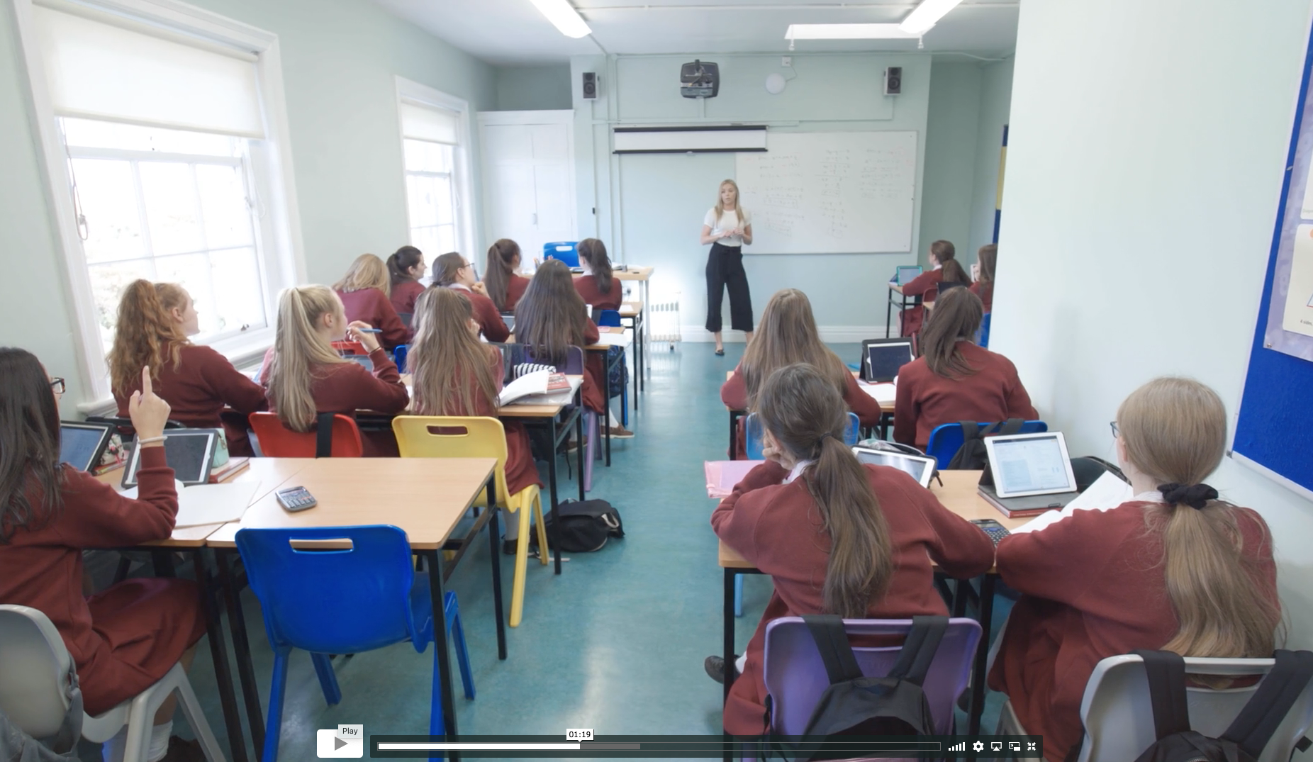

Slide 26
Courses and Levels:
Mixed ability classes.
Common level in 1st year with Ordinary level classes available in Maths from 2nd year and Irish from 3rd year as required.
Targeted approach with regard to learning support interventions - evidence based programme.
Courses and options will be covered by our Guidance Counsellor Mr O’Mahony
Notes:
Jane

Slide 27
Learning Support
Student Support Team led by Ms. Ann Freeman
Work closely with Guidance Counsellor and SMT
Continuum of Support - Support for All, Support for Some, Support for Few
Small classes or one to one
More than 10% of students are in receipt of Learning Support
Please contact the school if you have concerns about your daughter
Notes:
Jane

Slide 28
Learning Support
Educational Psychological Reports - email to info@loretothegreen.ie
Meetings via zoom will be arranged by the Student Support Coordinator in March
Notes:
Jane

Slide 29
Wellbeing
SPHE - Social Personal and Health Education
RSE - Relationship and Sexuality Education
PE
CSPE - Civic, Social and Political Education
Computers, Choir and Games
Subject specific wellbeing
Notes:
Jane

Slide 30
Loreto College
St. Stephen’s Green
Extra Curricular Activities
Notes:
Jane

Slide 31
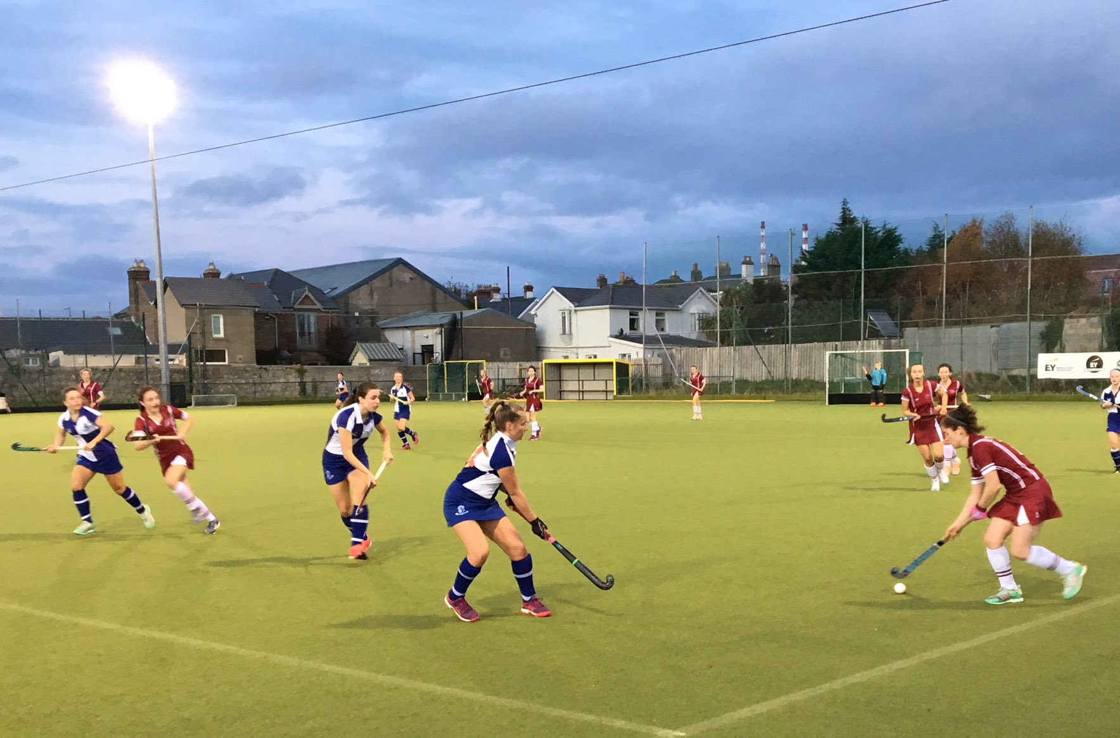
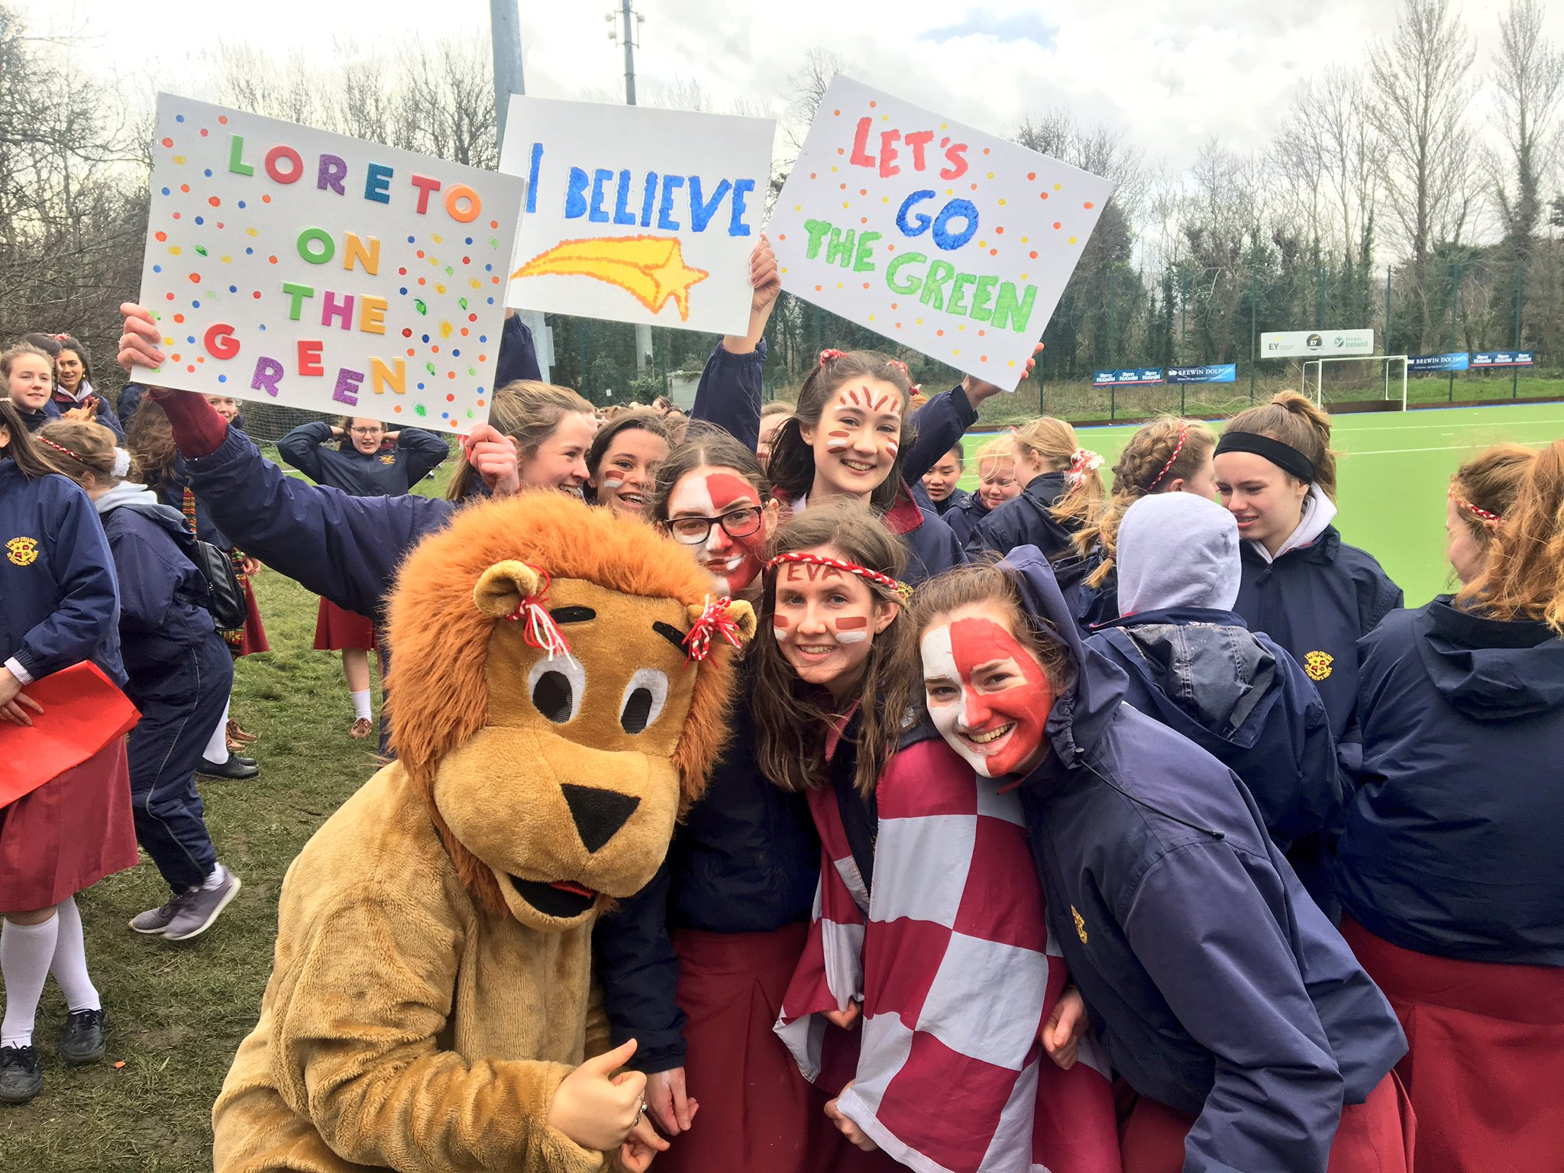
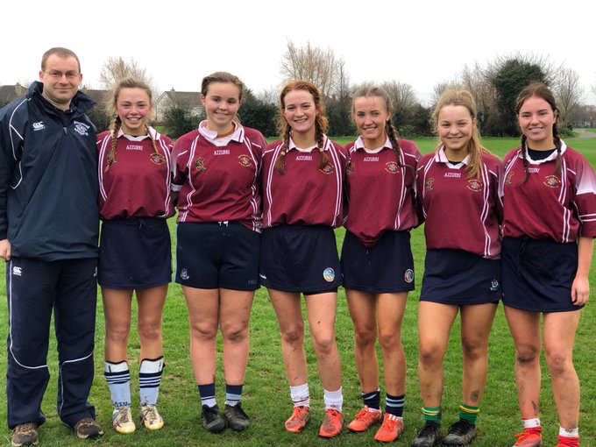
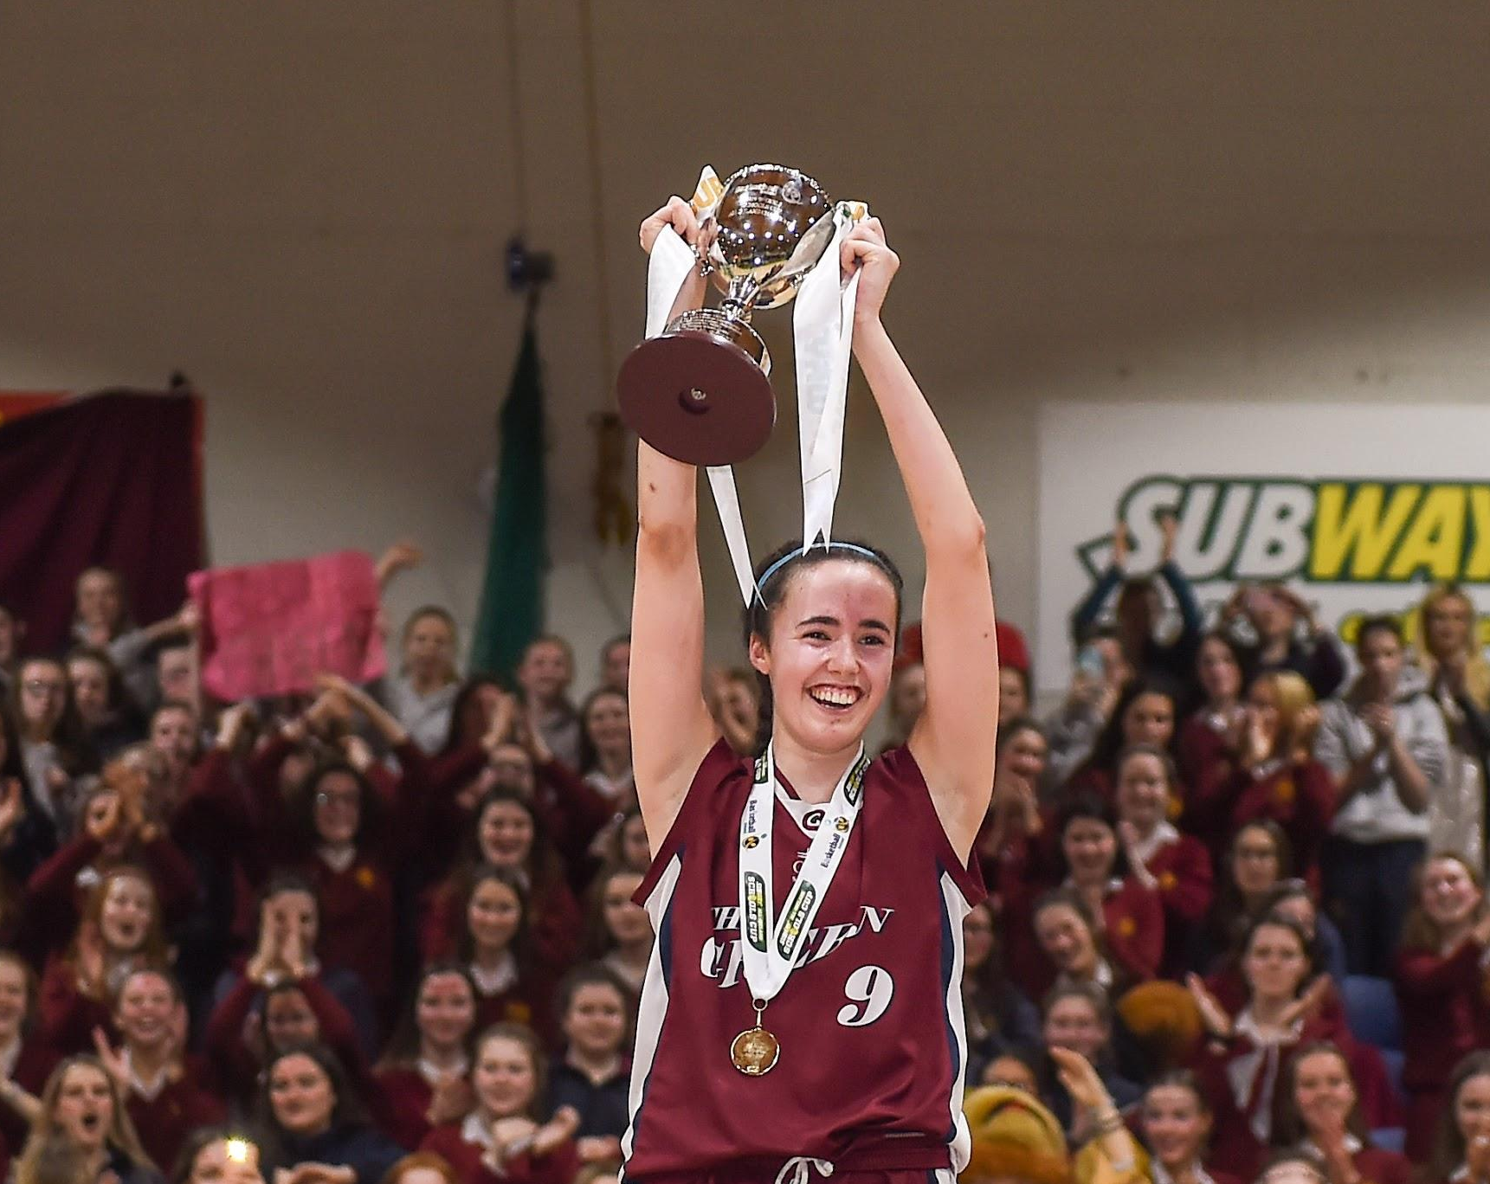
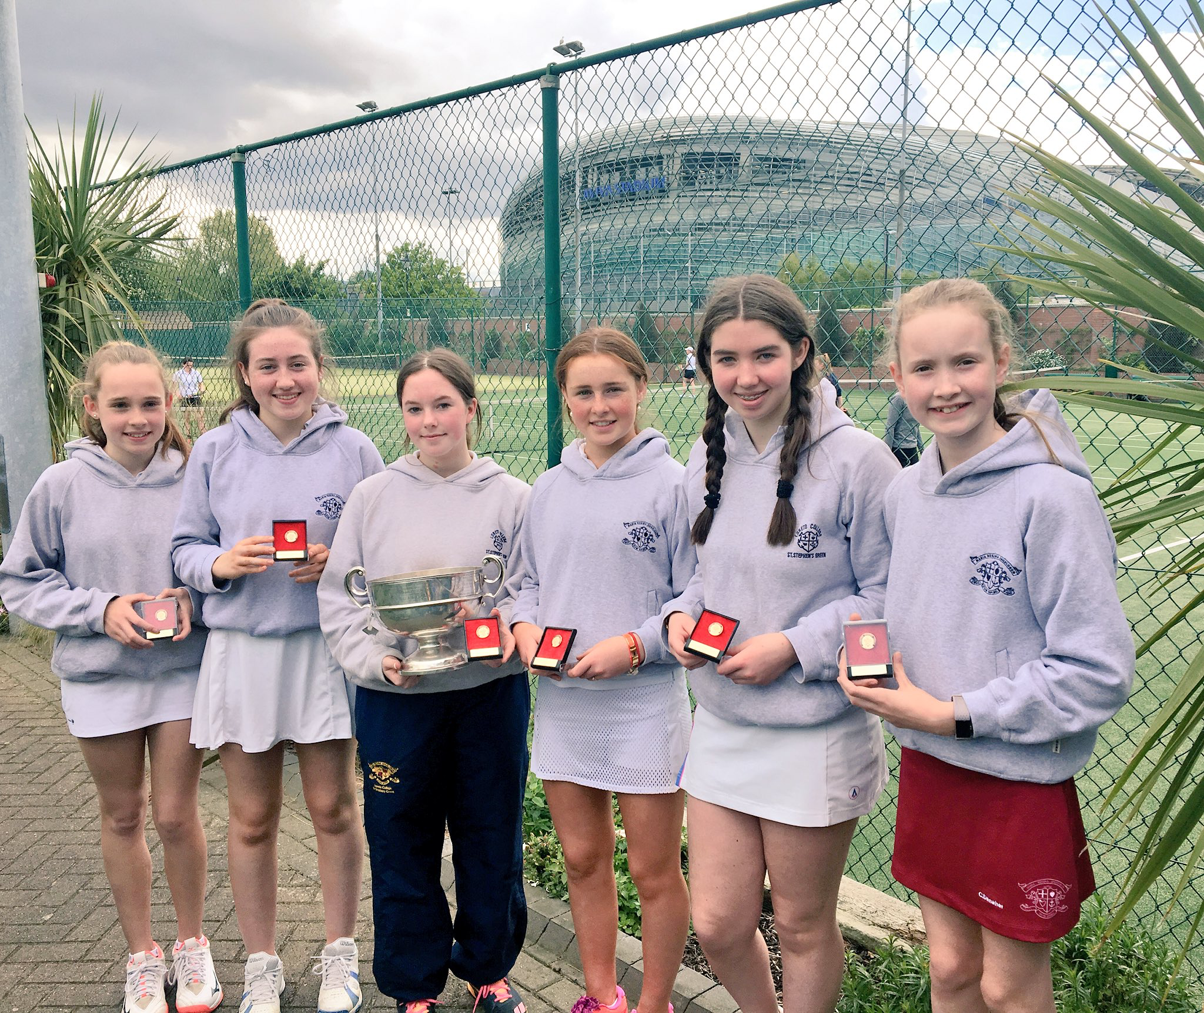
Loreto Sports
Meagan Hoffman (Sports Coordinator)- organises & looks after all the extra curricular sports in the school
Sports offered in Loreto:
Hockey, Basketball, Gaelic, Camogie, Cross Country, Athletics, Tennis, Cricket, Gymnastics, Swimming, Lacrosse, Tag-Rugby, Soccer, Badminton, Table Tennis (*Sailing, Equestrian, Golf)
Notes:
Jane

Slide 32
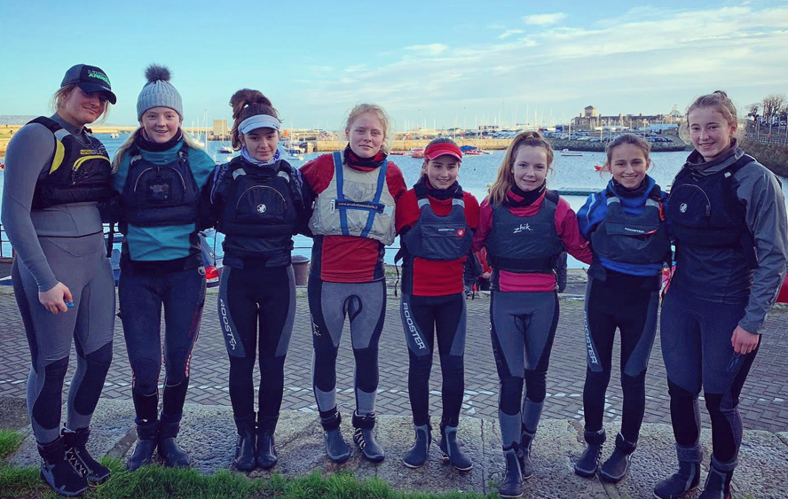
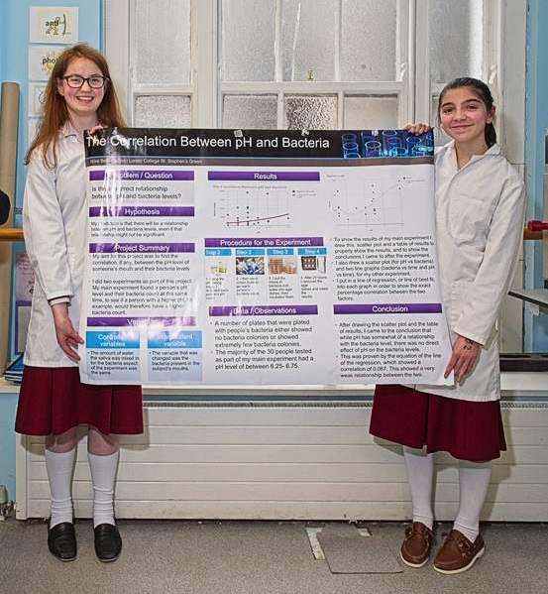
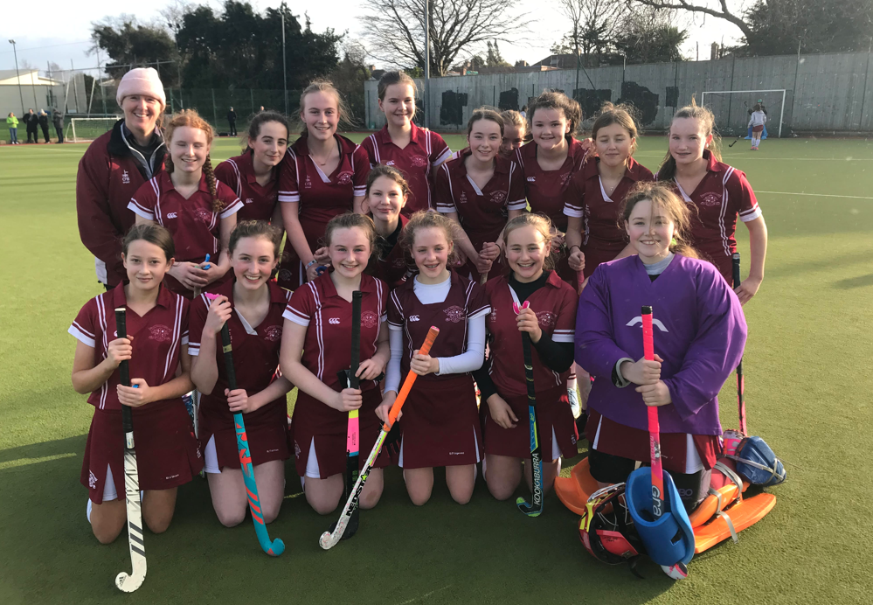
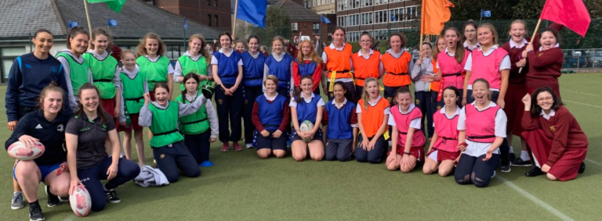
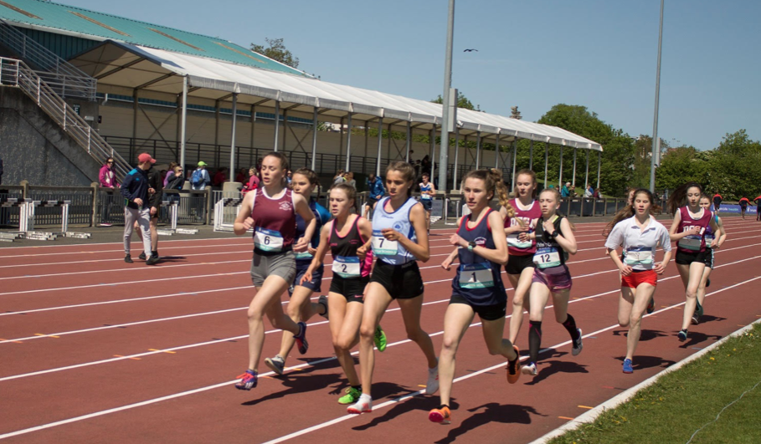
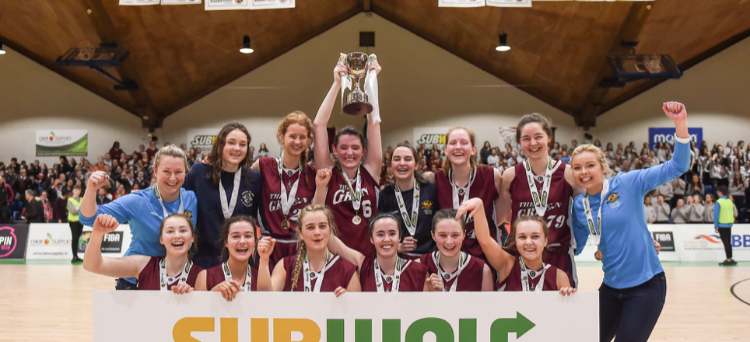
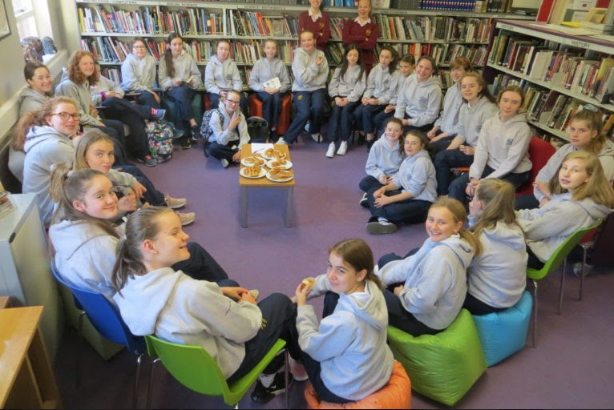
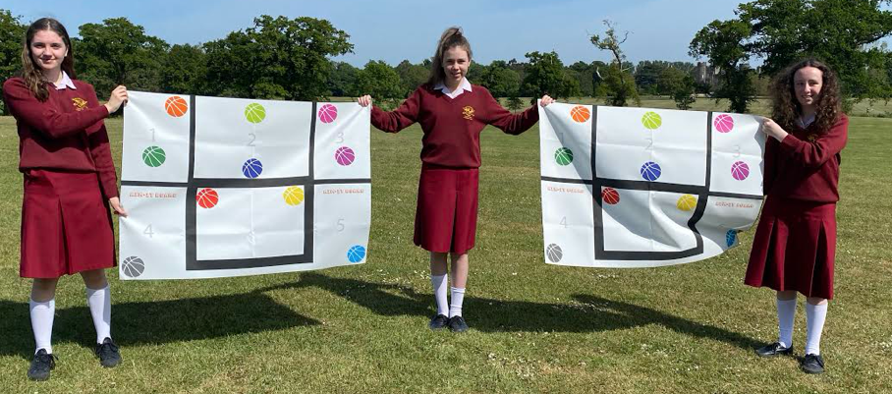
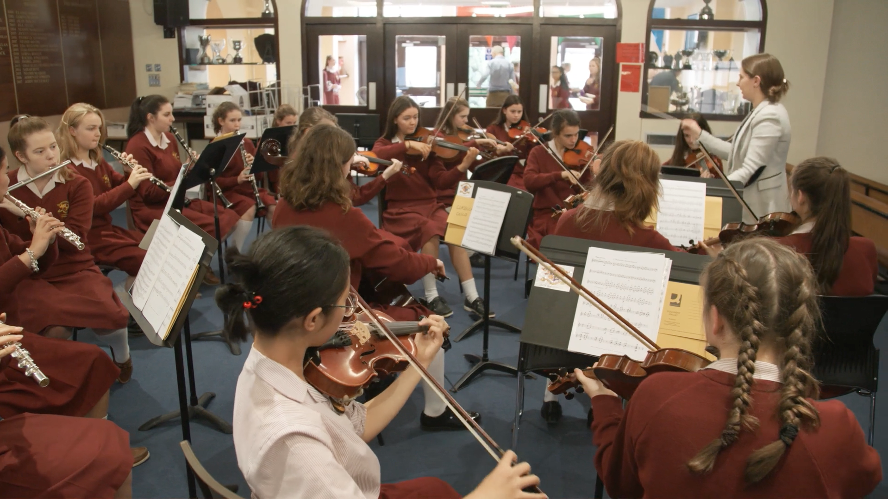
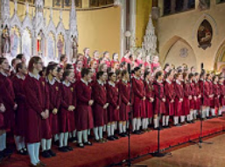
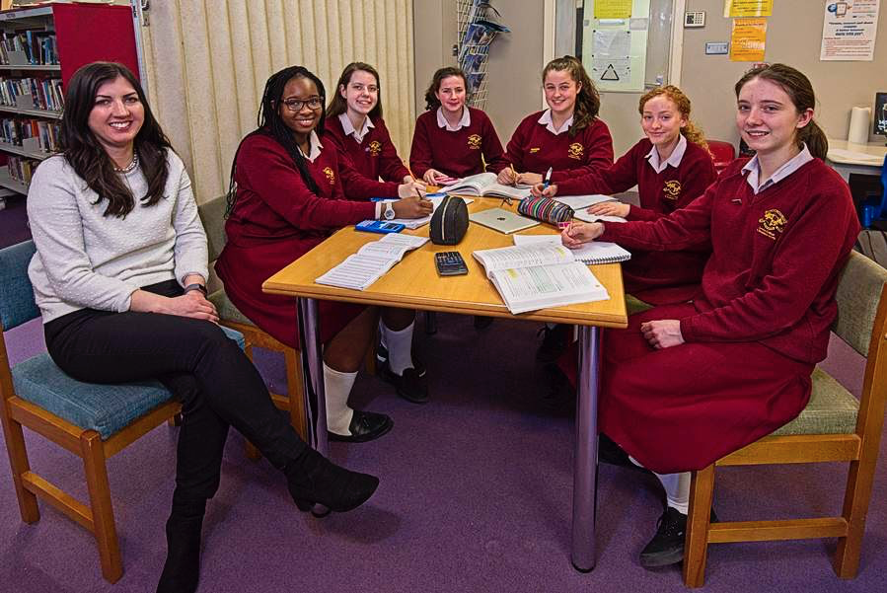
Extra curricular activities
Notes:
Jane

Slide 33
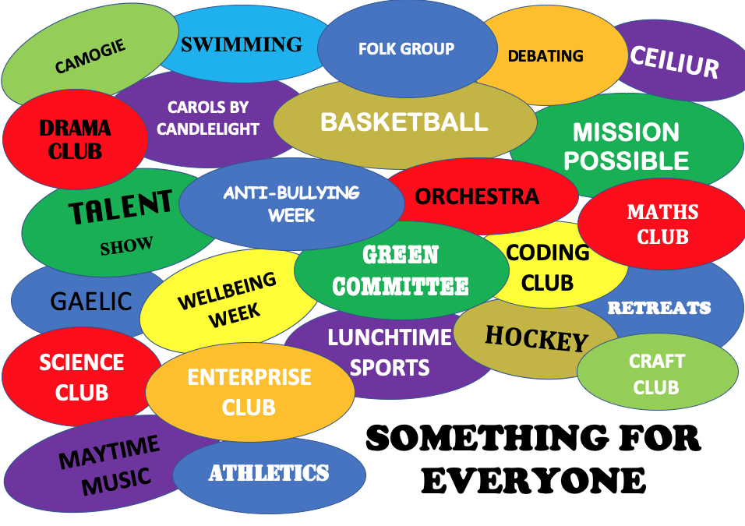
Notes:
Jane

Slide 34
Some Useful Resources to help the transition from Primary to Post Primary:
Notes:
Jane

Slide 35
Communication
School App
News and notifications
Record absences on the app
Communication tool between home and school
Notes:
Jackie

Slide 36
VSware
School Operating System - Login
Parent App Parent App - Everything you need to know
https://vsware.wistia.com/medias/n7yo7lck0k- Desktop
https://vsware.wistia.com/medias/nr3tejf165-- Android/Apple
Notes:
Jackie

Slide 37
Options for 1st Year
Guide to inputting subject options
ttps://vsware.wistia.com/medias/n7yo7lck0k
Notes:
Jackie

Slide 38
Loreto College
St. Stephen’s Green
Subject Options 2021
Mr O’Mahony
Guidance Counsellor
Notes:
Donnchadh as co-host to share screen

Slide 39
Loreto College
St. Stephen’s Green
iPad Training
CompuB
Notes:
Dave as co-host to share screen

Slide 40
Miscellaneous items:
Uniform suppliers -
Uniform and price list will be available in March
Information packs will be made available via email
on Wednesday 3rd February
Reminder - School App & Vsware
Notes:
Jackie

Slide 41
Resources and Contacts
Information packs will be made available on Wednesday 3rd February
info@loretothegreen.ie
www.loretothegreen.ie
Step Up to Secondary School
Gov.ie Back to School
Notes:
Jackie

Slide 42
Thank you
Notes:
Jackie

